Slide 1
SAT and ACT
College Prep
Mr. Gordon
jgordon@bisdtx.org

Slide 2
Upcoming Events
hi

Slide 3
SAT and ACT
Both of these are general tests that can help students get in a better university or receive more scholarships.
A student can take it as many times as they would like, which is recommended since usually the more you take it the higher your score.
hi

Slide 4
SAT and ACT
Colleges will accept either the SAT or ACT.
In Texas, far more students take the SAT than the ACT (see next slide).
The SAT is usually preferable if you are thinking about a STEM major.
hi

Slide 5
SAT vs. ACT
You are here
hi

Slide 6
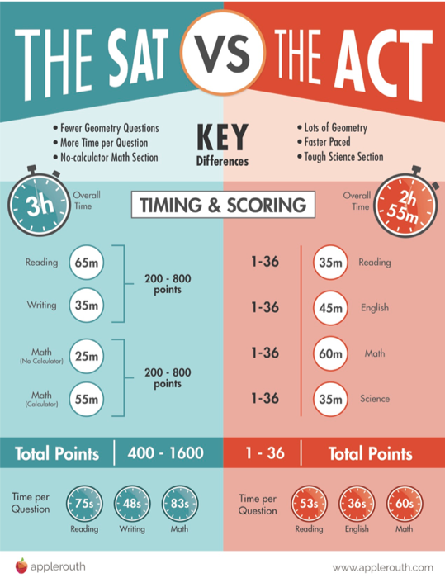
Key Differences
You will be taking the Preliminary SAT (PSAT) in the Fall of your Junior year, which is good practice.
You will take the actual SAT in the Spring of your Junior year. Both of these are offered at CRCA during school hours.
For these reasons, we will be focusing on the SAT.
hi

Slide 7
How much does it cost?
Since Covid, some universities have gone test optional, which means the SAT or ACT are not required.
However,
Earning a good score can help students get into the university of their choice and receive bigger scholarships.
hi

Slide 8
How much does it cost?
SAT and ACT fee waivers are available from Mrs. Jimenez.
Fee waivers allow you to take the test for free two times your Junior year and two times your Senior year.
Fee waivers can also be used to pay for college applications saving you hundreds of dollars. You must be eligible for free or reduced lunch to receive a fee waiver.
Otherwise, the SAT test is $55.
The ACT is $60, but has no waivers.
You can take it as a Sophomore, you will just need to pay the full amount.
hi

Slide 9
Where and When?
The SAT and ACT are offered at both Bastrop High School and
Cedar Creek High School.
Please see Mr. Gordon for test dates.
If you do not register by the registration deadline, you will be charged a late fee.
*Late fees do not apply to fee waivers, but seats fill up quickly and there may be no availability.*
hi

Slide 10
College Prep Assignment
In the comments section, answer the following question,
Who can give you a SAT Fee Waiver?
hi

